Slide 1

Stage 7 To Omega Course Designer: Jay Slater
To Omega is a 24 round, 120 point Comstock Long course. There are 10 USPSA targets and 4 steel targets. The best two hits per target will score. Steel must fall to score. The start signal is audible.
The Handgun start position is standing anywhere with wrists below belt. Handgun is loaded and holstered. The PCC start position is standing anywhere, PCC loaded, stock on belt, safety on.
On the audible start signal, engage all targets from within the shooting area.

Slide 2
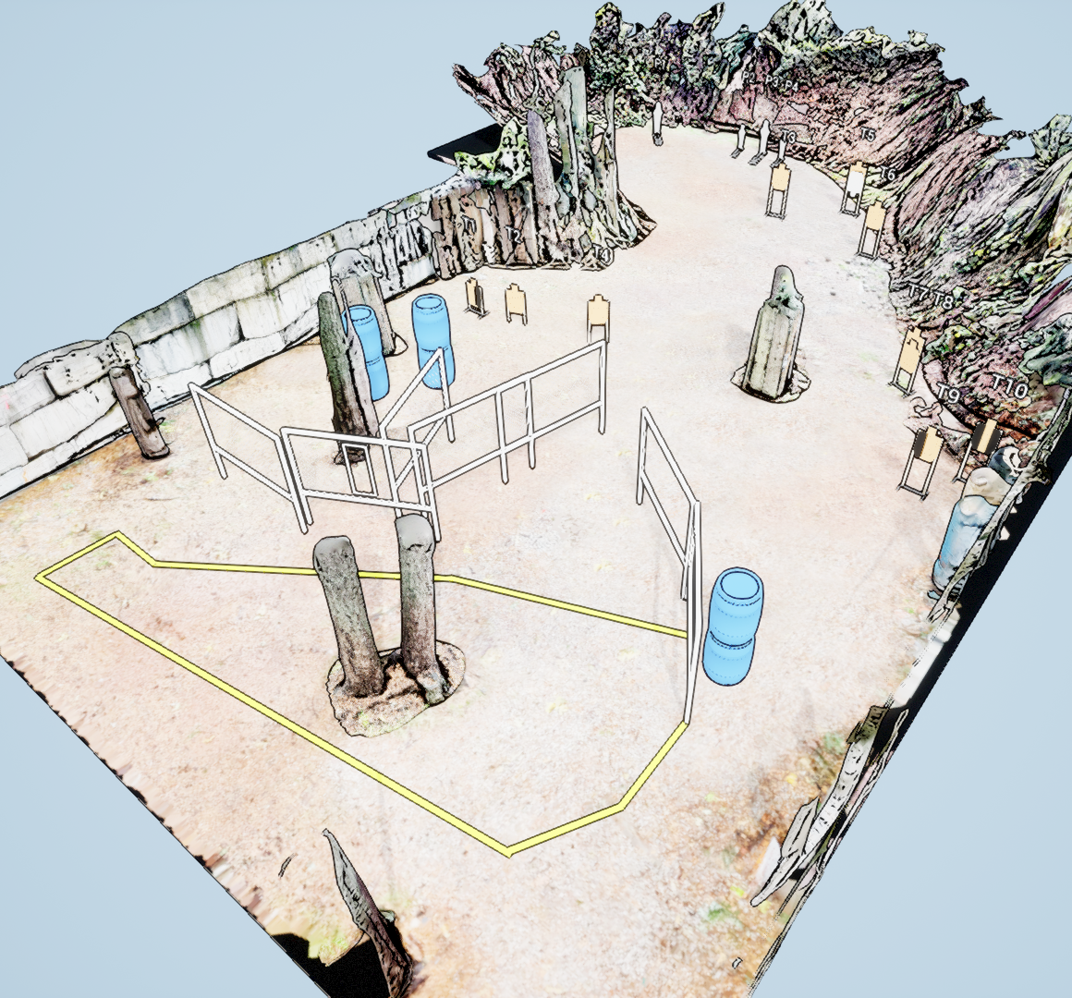
 | Stage 7 To Omega Course Designer: Jay Slater

